Slide 1
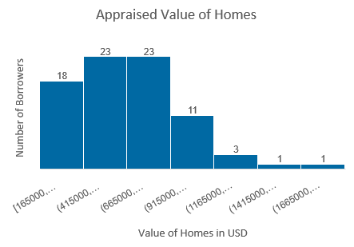
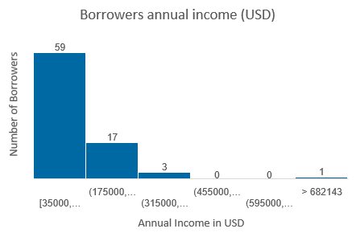
Data Analysis: Sales Prospects from Home Mortgage Data
From the charts above it is observed that both the appraised home value and borrowers annual income distribution is positively skewed (non-symmetric) with some outliers.
Therefore in the following analysis I have considered the benchmark against median income in local area to allow for spread across all the local areas.

Slide 2
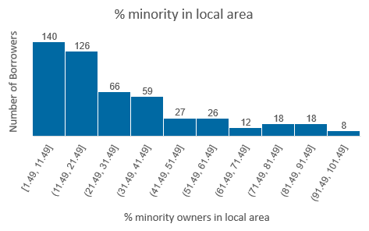
Data and Observation

Slide 3
Data and Observation

Slide 4
Observations and Key Insights
The distribution of percentage minority in local areas is right skewed while the age of borrowers is normally distributed.
It is also observed that more than half of the homes are located in local areas having less than 20% minority owners and the average % minority across the local areas is 28. (median = 19.65, Mean= 28.32).
A major outlier was found in the area location code 6, which have the highest number of house owners (80 which is 16% of the entire sample). The second highest which is area 48, has 31 which is less than half of area 6. Location area 6 also have the largest concentration of minority owners with an average of 55% and some areas as high as 98.95%, and range of 88.43%.
We can also find similar pattern in home value with location area 6 having an outlier in the total amount of valued homes per area column. The total value of homes in location area code 6 is over 54million USD which is almost 5 times the second highest (location area 8) at 11.5million USD.
Risk assessment on the borrowers was also done using the DTI column with range between 0 to 30% for low risk, 30 to 40% for medium risk and > 40% for high risk.
55.8% of borrowers classified as low risk, 27% as high risk, and 17.2% medium risk.

Slide 5
Insights and Recommendation
The sales leads analysis above shows that the criteria with the highest criteria leads is LTV ratio
less than 80 followed by the number of borrowers with income greater than the median income in their local areas. Although single criteria shows more potential leads, the risk is equally higher.
Therefore the business should be focussed on the multiple criteria for its potential leads and also focus on the customers from area location code 6 to support the communities with higher minority population.
The most profitable leads and least risk will be in category with 1 (LTV, income and high home value = 150 leads)

